Slide 1
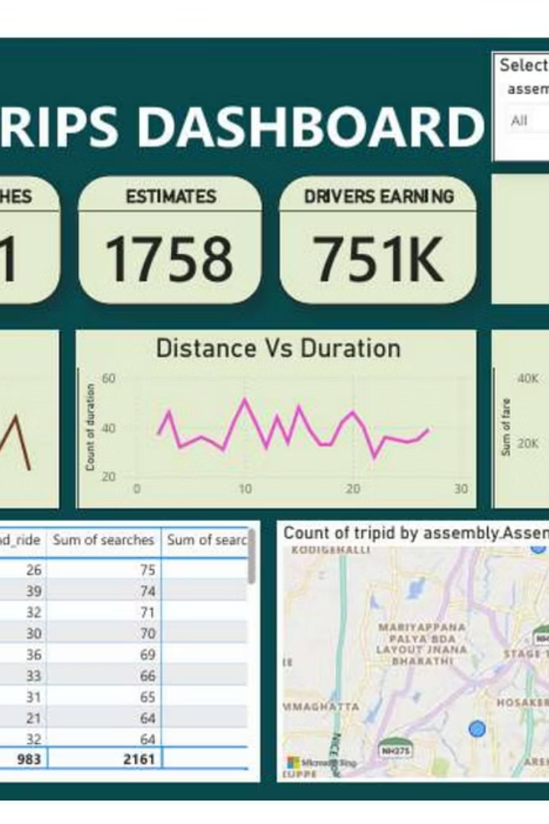
Revolutionising Legal Tech with AI
Welcome to our presentation on how our AI-powered platform is transforming the legal industry. We'll explore our core functionalities, market impact, and future vision.
SC
by Sarthak Chaudhary

Slide 2
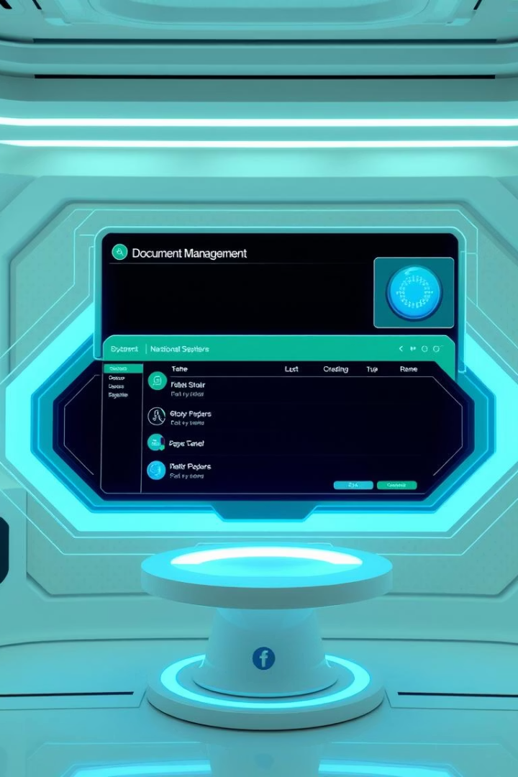
Core Functionality
1
Client Portal
Secure access for clients to case information and documents.
2
Document Management
Organise millions of legal documents efficiently.
3
NLP Semantic Search
Find relevant files based on context and user intent.
4
Contract Management
Handle half a million contracts with ease.

Slide 3
Addressing Key Pain Points
Streamlined Operations
Enhanced Efficiency
Automate routine tasks, reducing manual effort.
Quickly access information with advanced search.
Improve workflow efficiency for legal professionals.
Minimise time spent on administrative duties.

Slide 4

Comprehensive Legal Database
1M
0.5M
Country-wise Laws
Regulations
Extensive database covering laws globally.
Includes half a million regulatory documents.

Slide 5




Our Unique Selling Proposition
AI-Powered Insights
Robust Security
Global Coverage
Ensure data protection and compliance.
Leverage AI for deeper legal analysis.
Access laws and regulations worldwide.

Slide 6

Product Development Roadmap
1
Phase 1: Core Launch
Initial platform release with key features.
2
Phase 2: Feature Expansion
Introduce advanced AI capabilities and integrations.
3
Phase 3: Global Rollout
Expand market reach and language support.

Slide 7
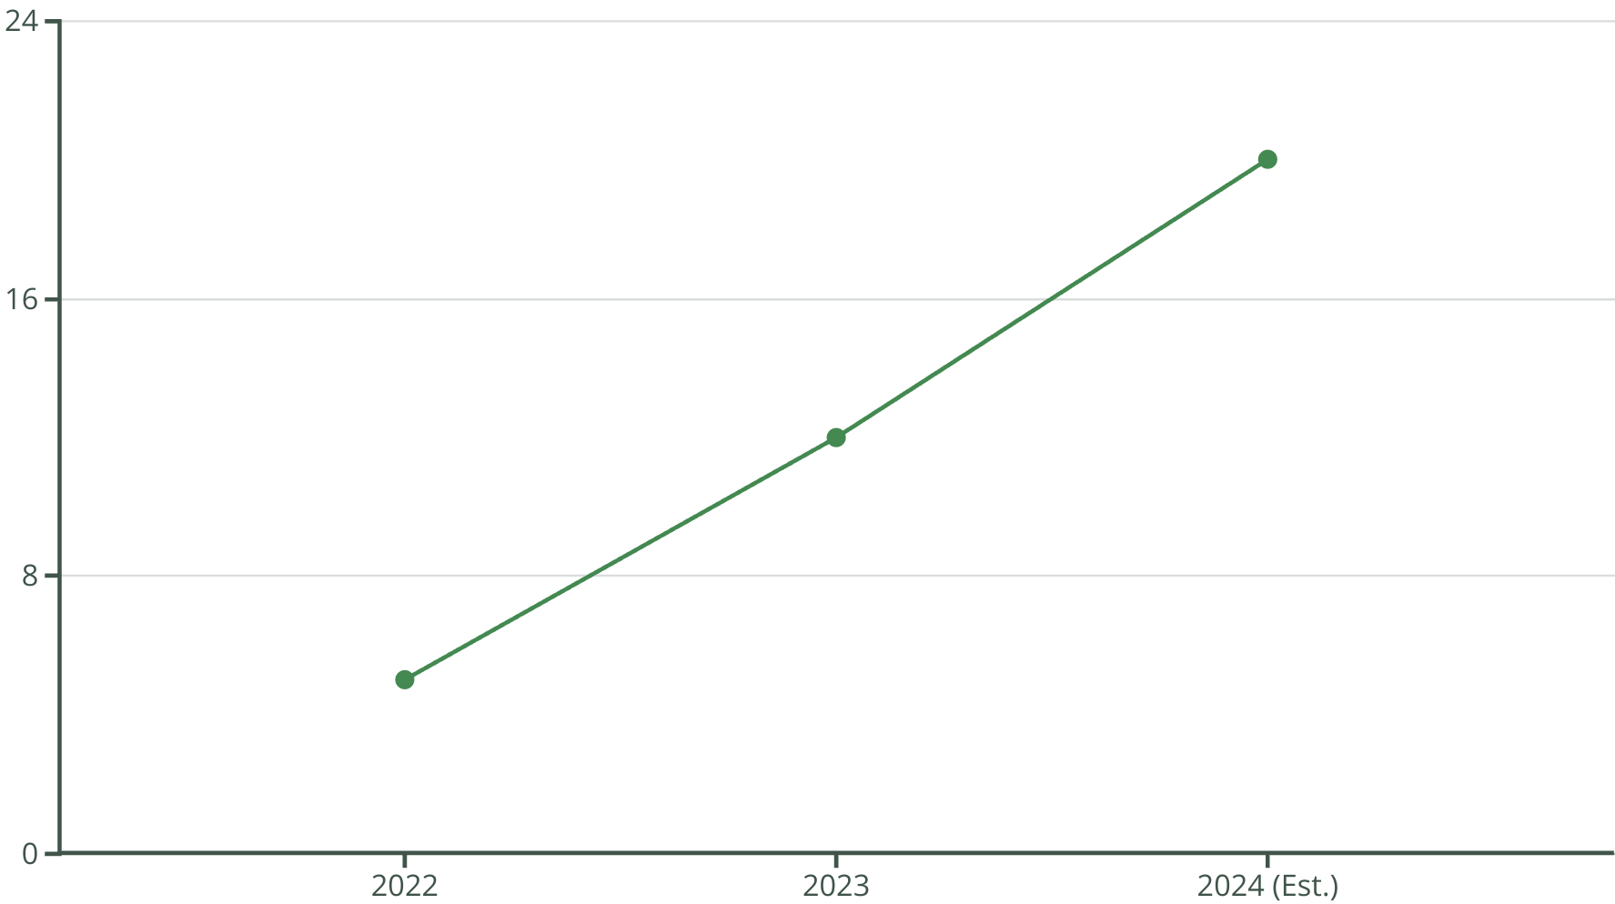
Market Impact and Growth
Our market share has grown significantly, demonstrating strong adoption. We project continued expansion in the coming years.

Slide 8

Future Vision
We aim to be the leading AI legal tech platform globally. Our focus is on continuous innovation and client success.
AI Integration
Global Expansion
Deeper AI capabilities for predictive analytics.
Reach new markets and legal jurisdictions.
User Experience
Enhance platform usability and accessibility.

